Slide 1

AE 482
Farm Machine Design
UNIT 4: Hydraulic Fluids
Mr. Joseph AVEYIRE
aveyire@yahoo.com // 024 4652593

Slide 2
Introduction
Unit four identifies hydraulic power transmission and hydraulic fluids.
Section 1-4 Explains the principle of hydraulic, and
Section 2-4 On the other hand handles hydraulic fluids.

Slide 3
UNIT 4: Learning Objectives
Explains hydraulic transmission of energy,
Describes the theory of lubrication,
Explains the classification of hydraulic fluids,
Explains the selection of hydraulic fluids

Slide 4
UNIT 4: Principles of Hydraulics
Hydraulic Transmission of Energy
There are two forms of science of hydraulics:
Hydrodynamics: Principle of moment of momentum and
Hydrostatics : Principles of positive displacement

Slide 5
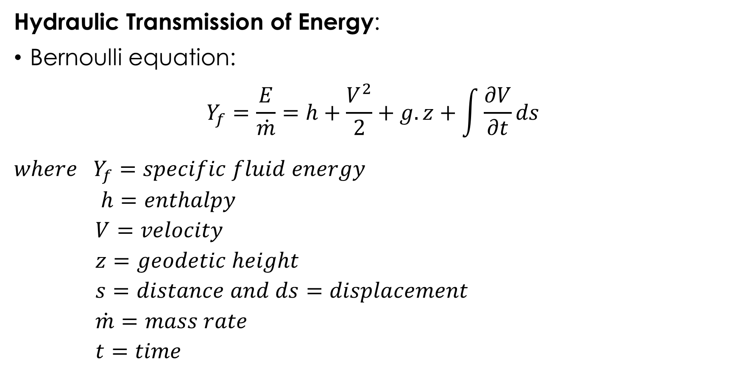
UNIT 4: Principles of Hydraulics
Hydraulic Transmission of Energy:
Bernoulli equation:
$$Y_{f}=\frac{E}{\dot{m}}=h+\frac{V^{2}}{2}+g.z+\int{\frac{∂V}{∂t}ds}$$
$$where Y_{f}=specific fluid energy$$
$$h=enthalpy$$
$$V=velocity$$
$$z=geodetic height$$
$$s=distance and ds=displacement$$
$$\dot{m}=mass rate$$
$$t=time$$

Slide 6
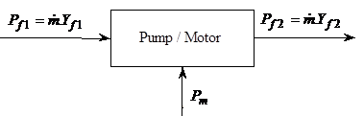
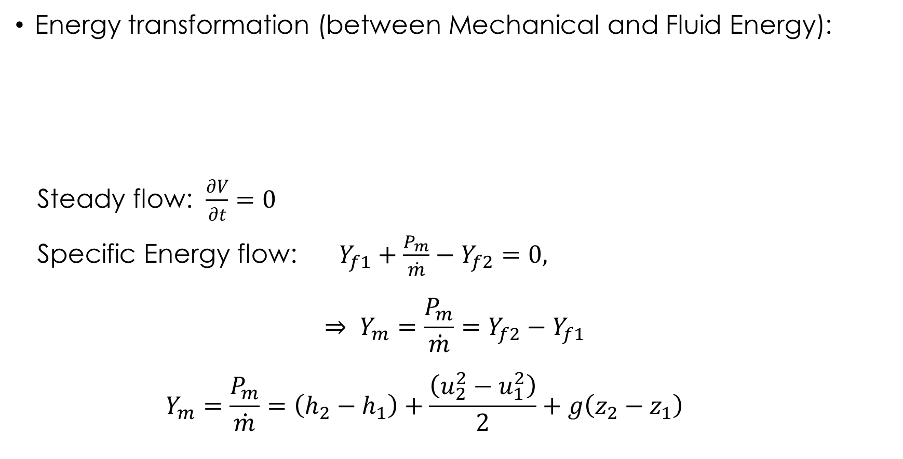
UNIT 4: Principles of Hydraulics
Energy transformation (between Mechanical and Fluid Energy):
Steady flow: $\frac{∂V}{∂t}=0$
Specific Energy flow: $Y_{f1}+\frac{P_{m}}{\dot{m}}−Y_{f2}=0,$
$$⇒ Y_{m}=\frac{P_{m}}{\dot{m}}=Y_{f2}−Y_{f1}$$
$$Y_{m}=\frac{P_{m}}{\dot{m}}=\left(h_{2}−h_{1}\right)+\frac{\left(u_{2}^{2}−u_{1}^{2}\right)}{2}+g\left(z_{2}−z_{1}\right)$$

Slide 7
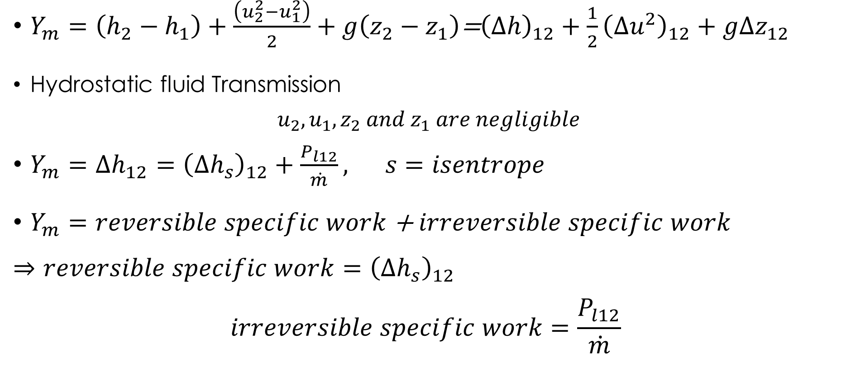
UNIT 4: Principles of Hydraulics
$Y_{m}=\left(h_{2}−h_{1}\right)+\frac{\left(u_{2}^{2}−u_{1}^{2}\right)}{2}+g\left(z_{2}−z_{1}\right)$=${\left(∆h\right)}_{12}+{\frac{1}{2}\left(∆u^{2}\right)}_{12}+g∆z_{12}$
Hydrostatic fluid Transmission
$$u_{2},u_{1}, z_{2} and z_{1} are negligible$$
$Y_{m}=∆h_{12}={\left(∆h_{s}\right)}_{12}+\frac{P_{l12}}{\dot{m}}, s=isentrope$
$Y_{m}=$ $reversible specific work$ + $irreversible specific work$
$$⇒reversible specific work={\left(∆h_{s}\right)}_{12}$$
$$irreversible specific work=\frac{P_{l12}}{\dot{m}}$$

Slide 8
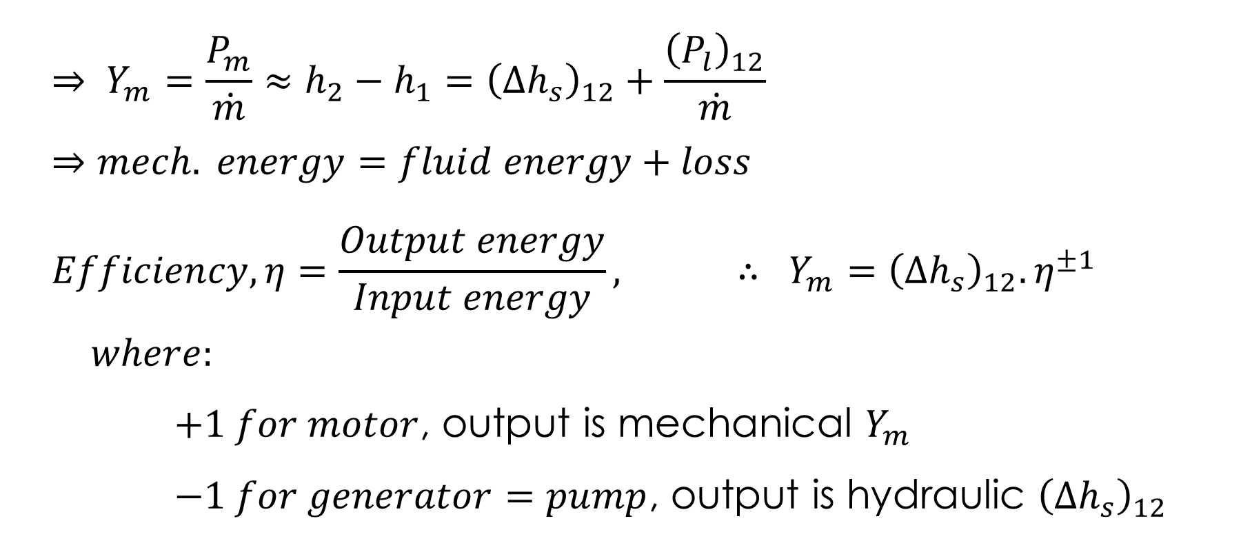
UNIT 4: Principles of Hydraulics
$$⇒ Y_{m}=\frac{P_{m}}{\dot{m}}≈h_{2}−h_{1}={\left(∆h_{s}\right)}_{12}+\frac{{\left(P_{l}\right)}_{12}}{\dot{m}}$$
$$⇒mech. energy=fluid energy+loss$$
$$Efficiency, η=\frac{Output energy}{Input energy}, ∴ Y_{m}={\left(∆h_{s}\right)}_{12}.η^{±1}$$
$$where:$$
$+1 for motor$, output is mechanical $Y_{m}$
$−1 for generator=pump$, output is hydraulic ${\left(∆h_{s}\right)}_{12}$

Slide 9
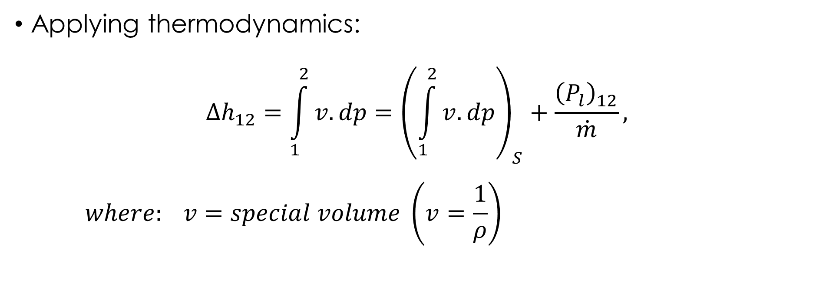
UNIT 4: Principles of Hydraulics
Applying thermodynamics:
$$∆h_{12}=\int_{1}^{2}{v.dp}={\left(\int_{1}^{2}{v.dp}\right)}_{S}+\frac{{\left(P_{l}\right)}_{12}}{\dot{m}},$$
$$where: v=special volume \left(v=\frac{1}{ρ}\right)$$

Slide 10
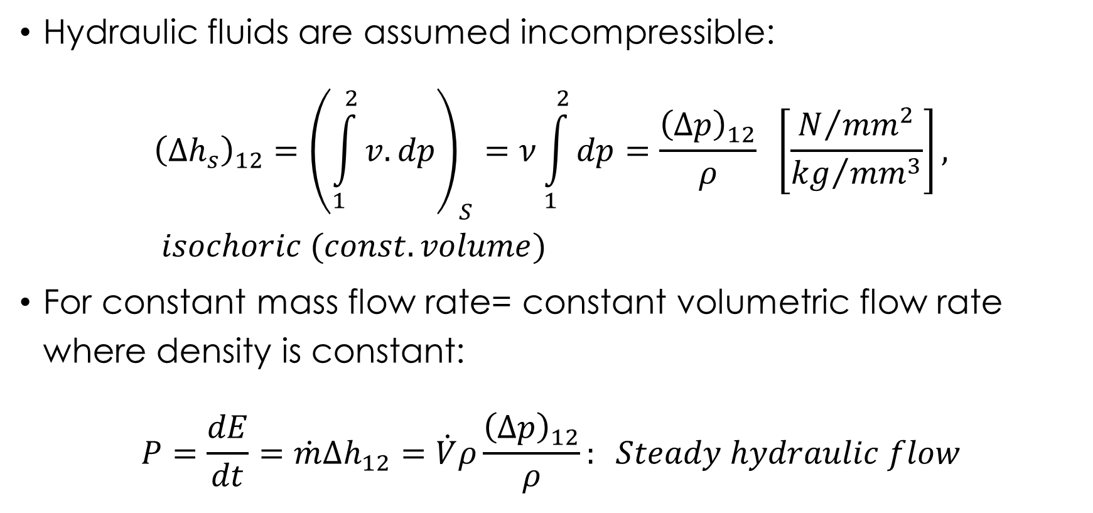
UNIT 4: Principles of Hydraulics
Hydraulic fluids are assumed incompressible:
$${\left(∆h_{s}\right)}_{12}={\left(\int_{1}^{2}{v.dp}\right)}_{S}=ν\int_{1}^{2}{dp}=\frac{{\left(Δp\right)}_{12}}{ρ} \left[\frac{N/{{mm}^{2}}}{{kg}/{{mm}^{3}}}\right], isochoric (const. volume)$$
For constant mass flow rate= constant volumetric flow rate where density is constant:
$$P=\frac{dE}{dt}=\dot{m}Δh_{12}=\dot{V}ρ\frac{{\left(Δp\right)}_{12}}{ρ}: Steady hydraulic flow$$

Slide 11
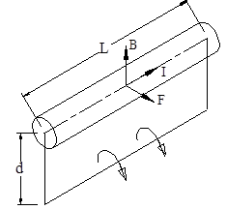
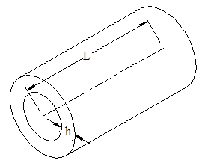
UNIT 4: Principles of Hydraulics
Comparison of Hydraulic Transmission to other Forms:
Force Density: Electric motor
A conductor carrying an electric electrical current in a magnetic field experiences an electrical force governed by the Fleming’s left-hand rule (As in Electric motor).

Slide 12
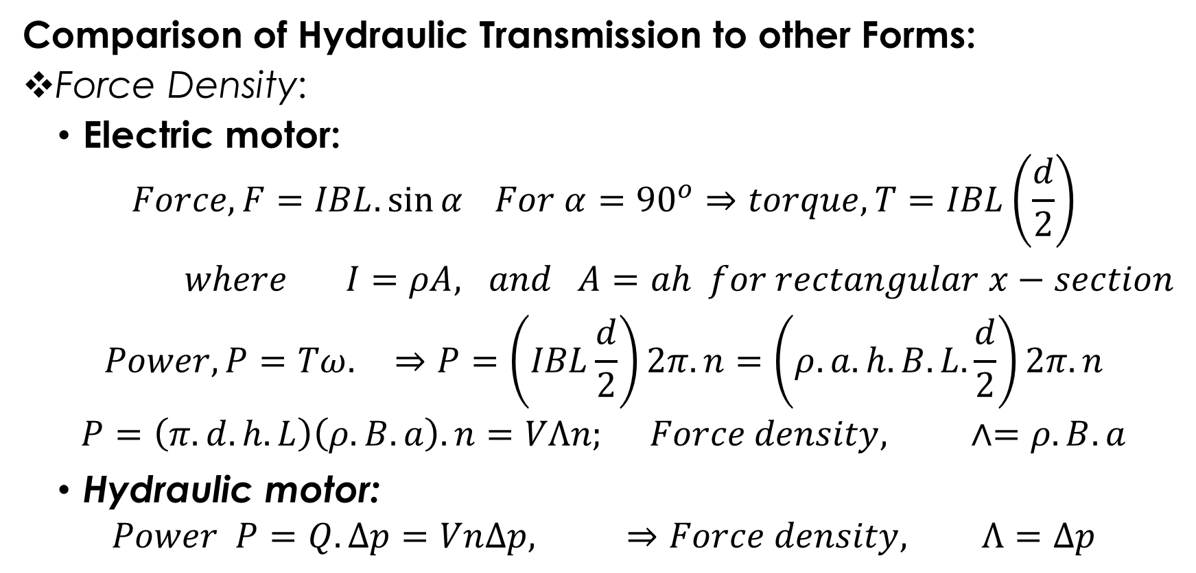
UNIT 4: Principles of Hydraulics
Comparison of Hydraulic Transmission to other Forms:
Force Density:
Electric motor:
$$Force, F=IBL.\sin{α} For α={90}^{o}⇒torque, T=IBL\left(\frac{d}{2}\right)$$
$where I=ρA, and A=ah for rectangular x−section$
$$Power, P=Tω. ⇒P=\left(IBL\frac{d}{2}\right)2π.n=\left(ρ.a.h.B.L.\frac{d}{2}\right)2π.n$$
$$P=\left(π.d.h.L\right)\left(ρ.B.a\right).n=VΛn; Force density, ∧=ρ.B.a$$
Hydraulic motor:
$$Power P=Q.∆p=Vn∆p, ⇒Force density, Λ=∆p$$

Slide 13
UNIT 4: Principles of Hydraulics
Comparison of Hydraulic Transmission to other Forms:
Distance: Possible to connect components at distances apart with hoses and pipes,
Control: There are simple standard parts available for both hydraulic and electrical transmissions controls.
Efficiency: Low due to presence of complex resistance (ohm, capacitance and inductance) in hydraulic transmissions
Size: Small due to high force density.

Slide 14
UNIT 4: Principles of Hydraulics
Disadvantages of Hydraulic Transmission:
High Losses: Due to fluid friction in flows through pipes, hoses, changes in cross-sectional area; and losses due to leakages at high pressure and clearances.
Sensitivity: Sensitive to foreign particles.
Dependence: Depends on the properties of the fluid (maxi. Temperature, compressibility)
Slip: Slip during rotation (n)
Danger: Leakages and bursting of pipes are dangers to life and property.
Low-life: The high force density results in high frictional wear

Slide 15
UNIT 4: Principles of Hydraulics
Summary of Hydraulic Transmission to other Forms:
Criteria | Mechanical | Hydraulic | Electrical
Force Density | very good | good | bad
Transmission Distance | bad | good | very good
Control | bad | good | good
Safety | Approximately the same
Efficiency | good | bad | bad
Flexibility in structure | bad | good | very good
Cost of elements | expensive | expensive | cheap
Size | big | small | big

Slide 16
UNIT 4: Principles of Hydraulics
Applications of Fluid Power Transmission:
Fluid power is pervasive
Gas springs in office chairs
Air drills used by dentists,
Brakes in automobiles,
Practically to every large agriculture, construction and mining machine including harvesters, drills and excavators.

Slide 17
UNIT 4: Theory of Lubrication
Design and construction of machines are based on certain criteria such as:
Operational safety dimensioning and forming of machine elements for a given expected life-span depend upon:
forces
Geometric form
Material of element
Guaranteed functioning of a machine depends on:
co-existence of pairing elements at the point of contact (Technical mating system)

Slide 18
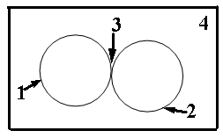
UNIT 4: Theory of Lubrication
Technical Mating System
The elements found within the technical mating system are:
  Primary body,
  Secondary body,
  Intermediary medium and
  Environment.
Properties of the elements are:
  Material properties of the elements,
  Form properties of the elements and
  Surface properties of the elements.

Slide 19
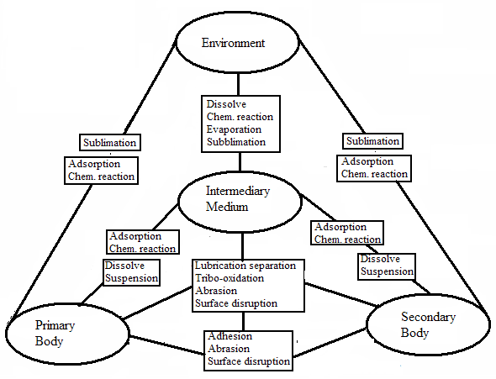
UNIT 4: Theory of Lubrication
Technical Mating System
Interactions
Example primary body and environment:
Sublimation
Adsorption
Chemical reaction

Slide 20
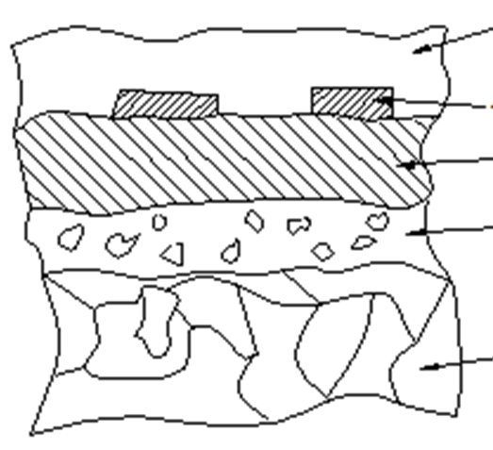
UNIT 4: Theory of Lubrication
Technical Mating System
Metallic Surface:
Consists of:
Impurities
Absorbed gases
On top of metallic surfaces:
Oxide layer
Cold-worked layer
Base material

Slide 21
UNIT 4: Theory of Lubrication
Wear
It is the progressive loss of material on surface of a solid body.
It is due to contact and relative motion of a solid body to a solid, liquid or gas medium
It is recognized by:
Presence of loose particles,
Change in material properties, and
Change in form.

Slide 22
UNIT 4: Theory of Lubrication
Factors Affecting Wear
Type of motion (sliding, rolling, impact etc.)
Trend of motion (continuous, intermittent, reversible, oscillation)
Forces/stresses (compression, tensile, etc)
Speed
Temperature
Duration or distance travelled
Properties of material
Form and nature of contact surfaces eg concave-convex surfaces, roughness

Slide 23
UNIT 4: Theory of Lubrication
Types of Wear (Mechanisms of Wear)
Tribo-oxidation (Oxidative Wear) is the removal of oxide-layer (layer activated by surface friction, medium and environment)
Adhesive Wear is characterised by building and breaking down of “welded” bridges (First, requires the break-down of the oxide-layer)
Abrasive Wear caused either by hard tips surface-profile or by the presence of hard foreign particles
Surface Disruption (surface fatigue) characterised by micro-cracks and breaking away of surface particles due to alternating mechanical stress . E.g.. pitting

Slide 24
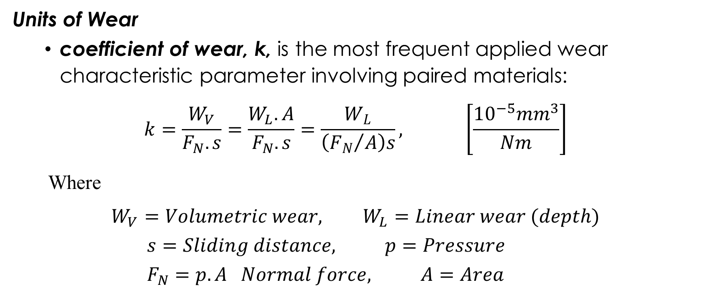
UNIT 4: Theory of Lubrication
Units of Wear
coefficient of wear, k, is the most frequent applied wear characteristic parameter involving paired materials:
$$k=\frac{W_{V}}{F_{N}.s}=\frac{W_{L}.A}{F_{N}.s}=\frac{W_{L}}{\left({F_{N}}/A\right)s}, \left[\frac{{10}^{−5}{mm}^{3}}{Nm}\right]$$
Where
$$W_{V}=Volumetric wear, W_{L}=Linear wear (depth)$$
$$s=Sliding distance, p=Pressure$$
$$F_{N}=p.A Normal force, A=Area$$

Slide 25
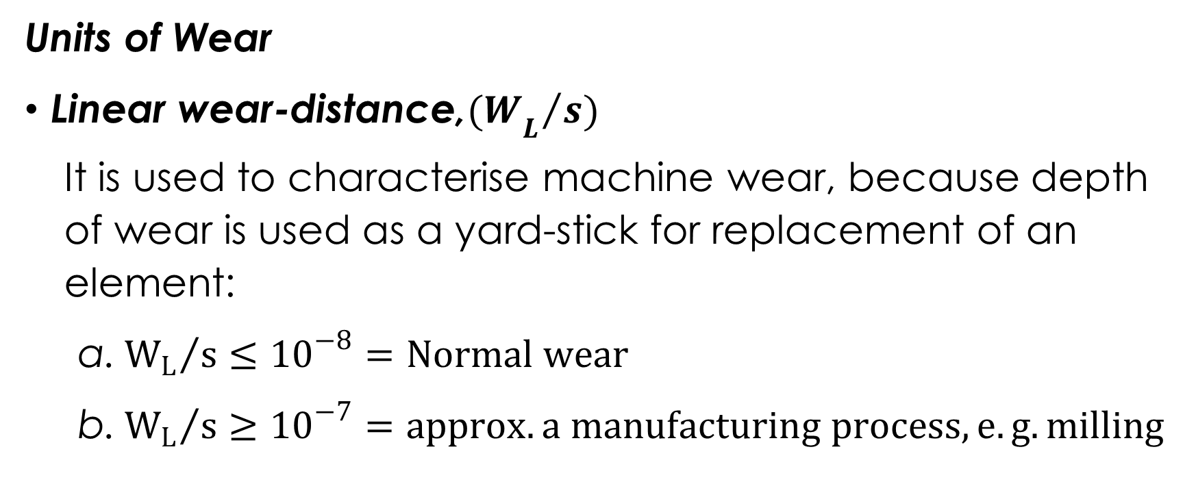
UNIT 4: Theory of Lubrication
Units of Wear
Linear wear-distance,${{(W}_{L}}/{s)}$
It is used to characterise machine wear, because depth of wear is used as a yard-stick for replacement of an element:
${W_{L}}/s≤{10}^{−8}=Normal wear$
${W_{L}}/s≥{10}^{−7}=approx. a manufacturing process, e.g. milling$

Slide 26
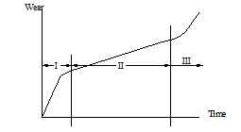
UNIT 4: Theory of Lubrication
Stages of Wear
Regressive wear (wear-in),
Linear wear,
Progressive.

Slide 27
UNIT 4: Classification of Hydraulic Fluids
Several criteria used to classify hydraulic fluids due to:
diverse areas of application of hydraulic systems,
diverse types of equipment available, and
increasing number /types of hydraulic fluids available.
Hydraulic fluids can therefore be classified based on:
physical properties,
chemical types,
operating capabilities,
utility, or specific applications.

Slide 28
UNIT 4: Classification of Hydraulic Fluids
Common classification criteria of hydraulic fluids are:
Classification by chemical properties: petroleum and non-petroleum hydraulic fluids.
Classification by physical properties: viscosity
1S0-VG,
Redwood-seconds
SAE for automobiles.
Classification by operating characteristics: temperature limits and the fire-resistant characteristics (DIN 51502 and ISO 67434)

Slide 29
UNIT 4: Classification of Hydraulic Fluids
Petroleum Based Hydraulic Fluids
They were among the first liquids employed as hydraulic fluids,
They have the bases of paraffin, olefin, naphten or asphalt,
Their properties depend upon:
chemical composition (origin), and
type of raffination.
They give outstanding performance, long life, good lubricating characteristics, and protection against rust, oxidation, corrosion, sludge, and foam formation.

Slide 30
UNIT 4: Classification of Hydraulic Fluids
ISO Classification of Hydraulic Fluids (ISO 6743-4)
Petroleum Based Hydraulic Fluids are categorized as:
HH hydraulic fluids do not have any additives,
HL type oils contain oxidation and rust inhibitors to protect equipment from chemical deterioration and water contamination,
HM are a version of HL-type fluids with improved anti-wear additives and improved high-pressure performance.

Slide 31
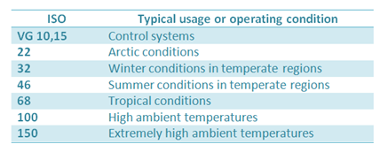
UNIT 4: Classification of Hydraulic Fluids
ISO-VG (ISO Viscosity Grades)
ISO viscosity grades classify hydraulic fluids based upon their kinematic viscosity at 40^{O}C.

Slide 32
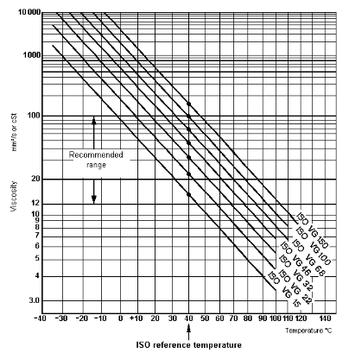
UNIT 4 : Classification of Hydraulic Fluids
Viscosity-temperature diagram,
Recommended Temp. Range

Slide 33
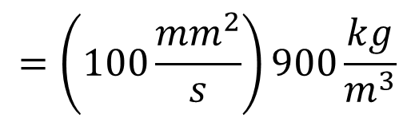

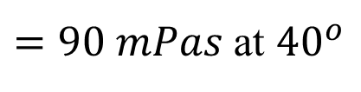
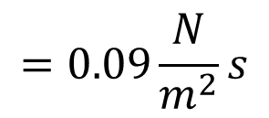
UNIT 4 : Classification of Hydraulic Fluids
Viscosity: (ISO-VG)
Specification of ISO-VG46 implies it is an oil of the viscosity class 46
Question:
Oil with specification ISO-VG100 has a density of 900kg/m³. What is the dynamic viscosity (η)?
Answer:
$$=\left(100\frac{{mm}^{2}}{s}\right)900\frac{kg}{m^{3}}$$
$$=0.09\frac{N}{m^{2}}s$$
$$η=ν.ρ$$
$=90 mPas$ at ${40}^{o}$

Slide 34
UNIT 4 : Classification of Hydraulic Fluids
SAE Viscosity Grade
  SAE VG gives no indication of quality and suitability of oil for a given application.
  According to SAE, there are two basic types of oil:
  Single grade
  Multi-grade

Slide 35
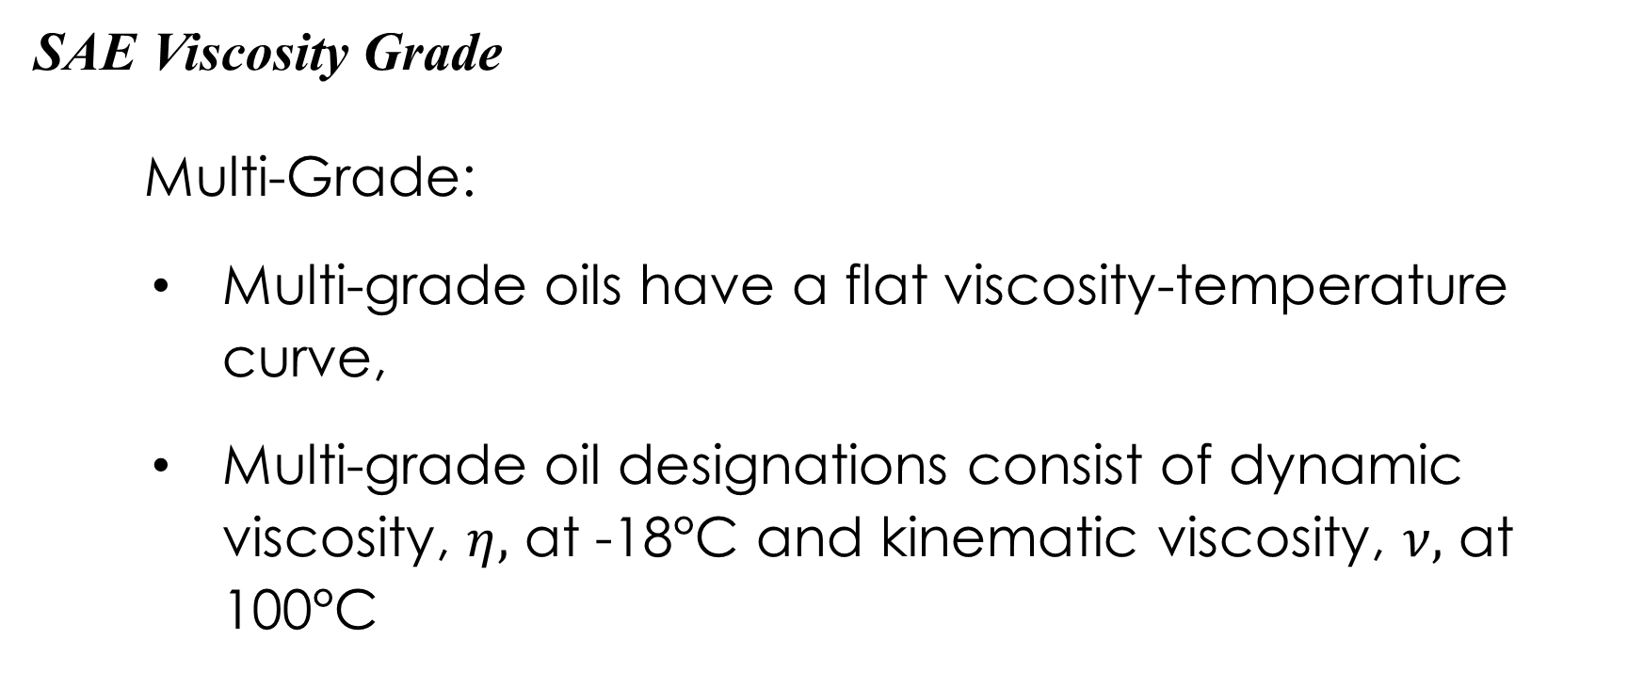
UNIT 4 : Classification of Hydraulic Fluids
SAE Viscosity Grade
Multi-Grade:
Multi-grade oils have a flat viscosity-temperature curve,
Multi-grade oil designations consist of dynamic viscosity, $η,$ at -18°C and kinematic viscosity, $ν,$ at 100°C

Slide 36
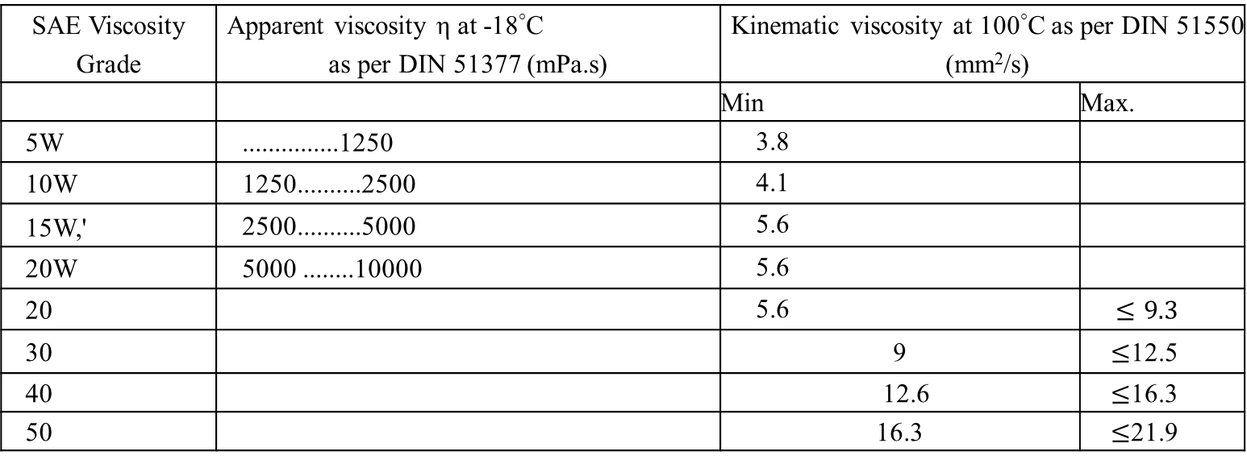
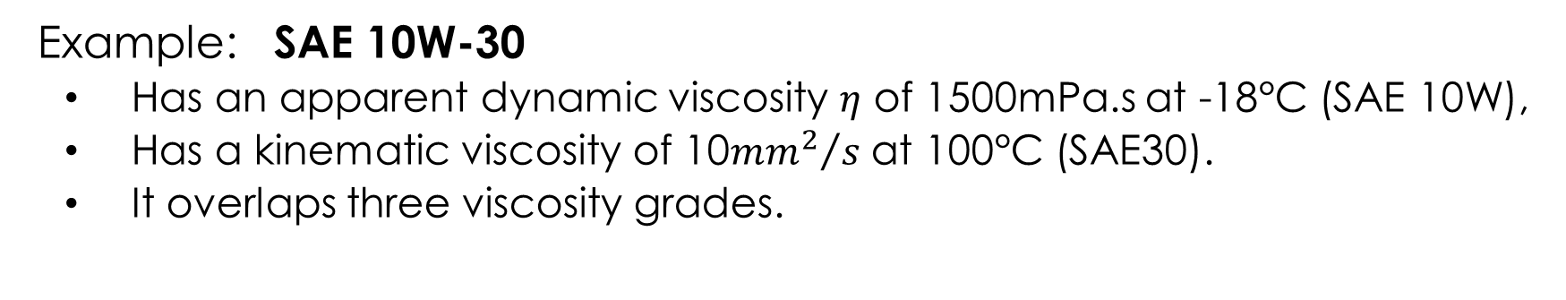
UNIT 4 : Classification of Hydraulic Fluids
Example: SAE 10W-30
Has an apparent dynamic viscosity $η$ of 1500mPa.s at -18°C (SAE 10W),
Has a kinematic viscosity of 10${{mm}^{2}}/s$ at 100°C (SAE30).
It overlaps three viscosity grades.
SAE Viscosity Grade | Apparent viscosity η at -18°C as per DIN 51377 (mPa.s) | Kinematic viscosity at 100°C as per DIN 51550 (mm²/s)
 |  | Min | Max.
5W | ...............1250 | 3.8
10W | 1250..........2500 | 4.1
15W,' | 2500..........5000 | 5.6
20W | 5000 ........10000 | 5.6
20 |  | 5.6 | $$≤9.3$$
30 |  | 9 | $≤$12.5
40 |  | 12.6 | $≤$16.3
50 |  | 16.3 | $≤$21.9

Slide 37
UNIT 4: Additives
Improve the properties of mineral oils based hydraulic fluids,
Types of additives:
viscosity index improver (VI),
oxidation and corrosion inhibitors,
high-pressure additives (EP), and
detergents and dispersants

Slide 38
UNIT 4: Additives
Properties of Fluid improved by additives:
  viscosity-temperature relationship,
  resistance of the oil to aging
  corrosive protection capacity,
  load carrying capacity in the mixed frictional state,
  stock point,
  foaming tendency, and
  air releasing capacity.

Slide 39
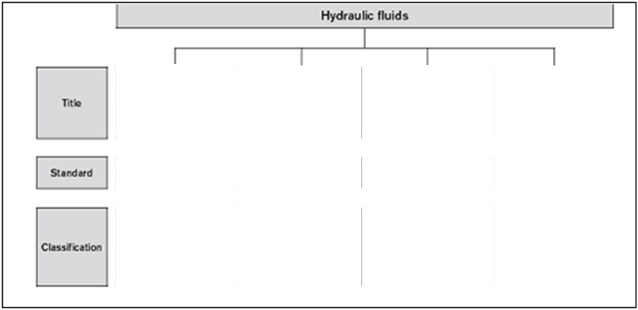
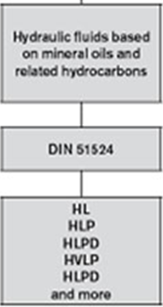
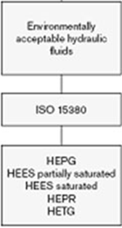
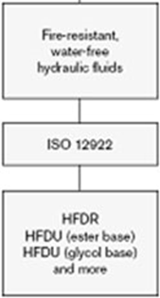
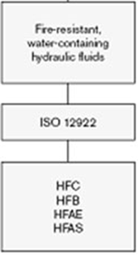
UNIT 4: Selection of Hydraulic Fluids
Based on compliance with the minimum requirements of DIN 51524

Slide 40
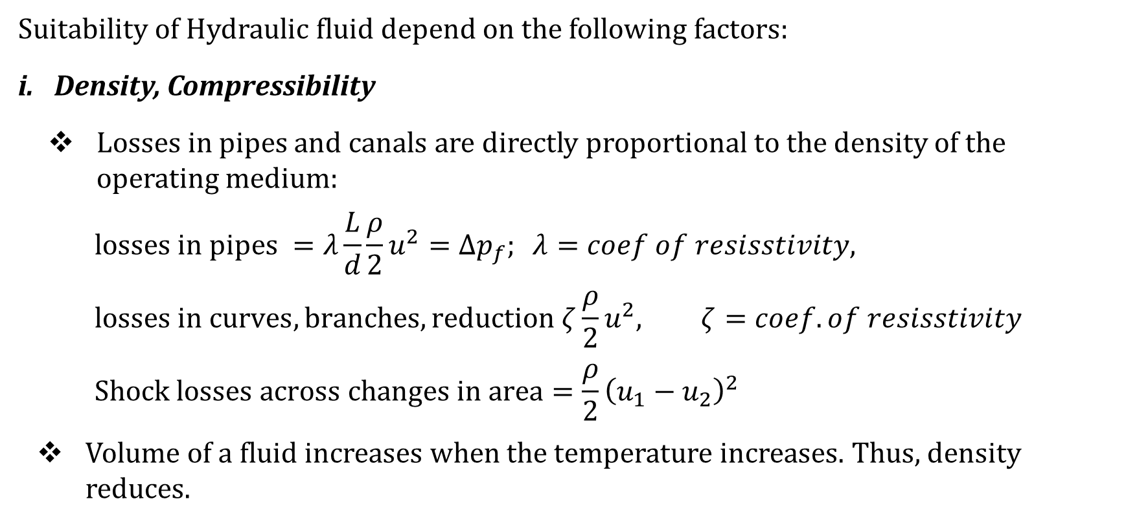
UNIT 4: Selection Criteria of Hydraulic Fluids
Suitability of Hydraulic fluid depend on the following factors:
Density, Compressibility
Losses in pipes and canals are directly proportional to the density of the operating medium:
$$losses in pipes =λ\frac{L}{d}\frac{ρ}{2}u^{2}=Δp_{f}; λ=coef of resisstivity,$$
$$losses in curves, branches, reduction ζ\frac{ρ}{2}u^{2}, ζ=coef. of resisstivity$$
$$Shock losses across changes in area=\frac{ρ}{2}{\left(u_{1}−u_{2}\right)}^{2}$$
Volume of a fluid increases when the temperature increases. Thus, density reduces.

Slide 41
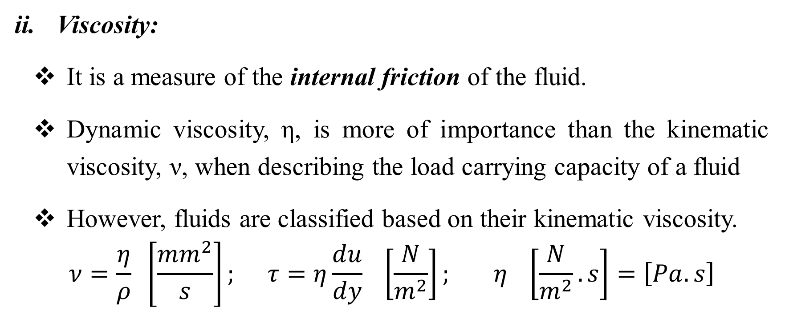
UNIT 4 : Selection Criteria of Hydraulic Fluids
Viscosity:
It is a measure of the internal friction of the fluid.
Dynamic viscosity, η, is more of importance than the kinematic viscosity, ν, when describing the load carrying capacity of a fluid
However, fluids are classified based on their kinematic viscosity.
$$ν=\frac{η}{ρ} \left[\frac{{mm}^{2}}{s}\right]; τ=η\frac{du}{dy} \left[\frac{N}{m^{2}}\right]; η \left[\frac{N}{m^{2}}.s\right]=\left[Pa.s\right]$$

Slide 42
UNIT 4 : Selection Criteria of Hydraulic Fluids
Viscosity:
Permissible viscosity range of a complete systems takes account of the permissible viscosity of all components,
Optimum operating viscosity range of each component should be kept within the permissible temperature range by:
either cooling or
heating, or both

Slide 43
UNIT 4 : Selection Criteria of Hydraulic Fluids
Viscosity:
Viscosity at operating temperature determines:
the response characteristics of closed control loops,
stability and damping of system,
the efficiency factor and
the degree of wear,

Slide 44
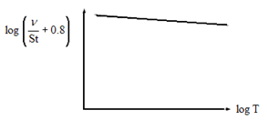
UNIT 4 : Selection Criteria of Hydraulic Fluids
Viscosity: (Viscosity-Temperature Relationship)
Viscosity drops when the temperature increases and rises when the temperature decreases,
Fluids with a low slope are suitable when used as hydraulic fluid,
A high VI means less temperature dependence

Slide 45
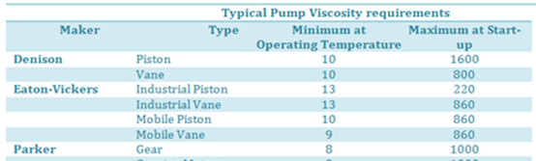
UNIT 4 : Selection Criteria of Hydraulic Fluids
Determining the correct viscosity grade for a particular application: Note
Start (maximum) viscosity at minimum ambient temperature,
Minimum viscosity at maximum expected operating temperature,
Permissible and optimum viscosity range for the system components.

Slide 46
UNIT 4 : Selection Criteria of Hydraulic Fluids
Viscosity: (Viscosity-Pressure Relationship)
This relationship is responsible for the loading ability of lubricating fluids,
increase in viscosity with an increase in pressure has a self-strengthening effect.

Slide 47
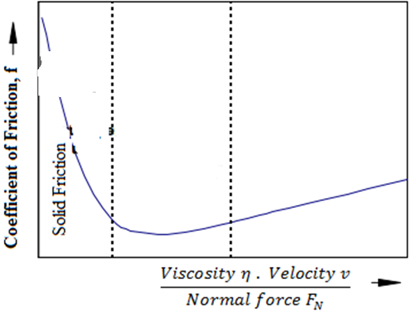

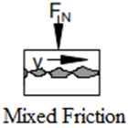
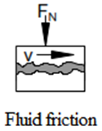
UNIT 4 : Selection Criteria of Hydraulic Fluids
Wear protection capability
Figure 4: Stribeck’s curve
Hydrodynamic lubrication requires high relative speeds between objects,
From start to final speed, the objects experience:
Solid friction state,
Mixed friction state,
Fluid friction state.

Slide 48
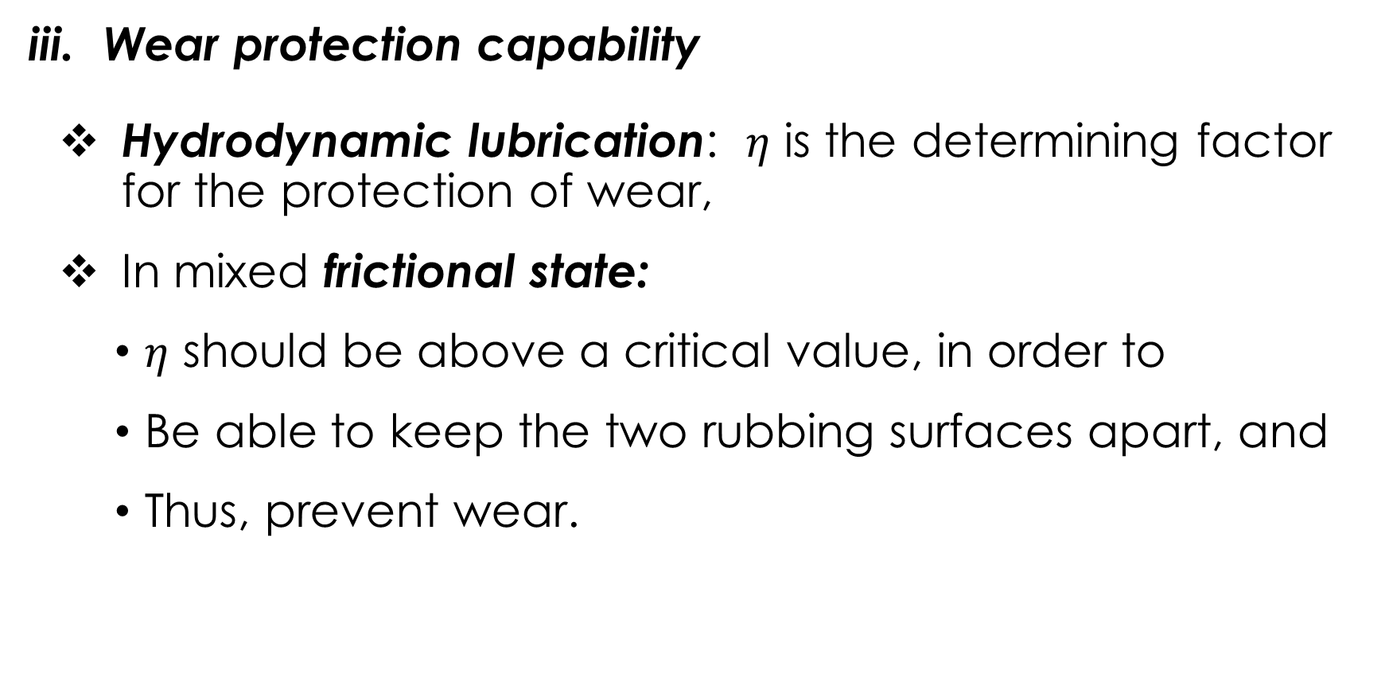
UNIT 4 : Selection Criteria of Hydraulic Fluids
Wear protection capability
Hydrodynamic lubrication: $η$ is the determining factor for the protection of wear,
In mixed frictional state:
$η$ should be above a critical value, in order to
Be able to keep the two rubbing surfaces apart, and
Thus, prevent wear.

Slide 49
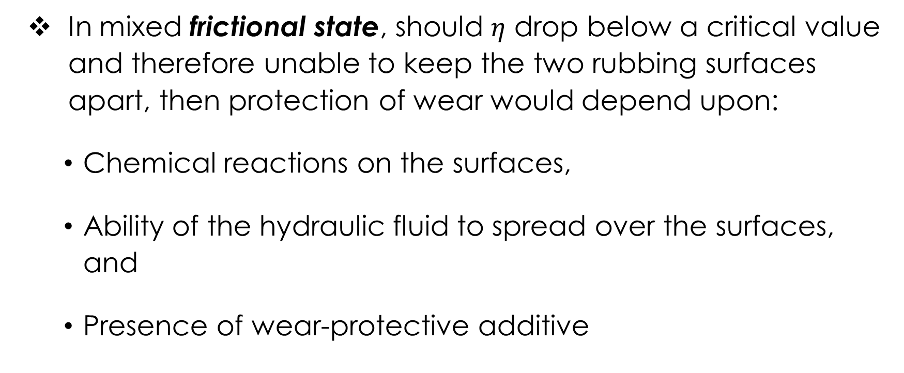
UNIT 4 : Selection Criteria of Hydraulic Fluids
In mixed frictional state, should $η$ drop below a critical value and therefore unable to keep the two rubbing surfaces apart, then protection of wear would depend upon:
Chemical reactions on the surfaces,
Ability of the hydraulic fluid to spread over the surfaces, and
Presence of wear-protective additive

Slide 50
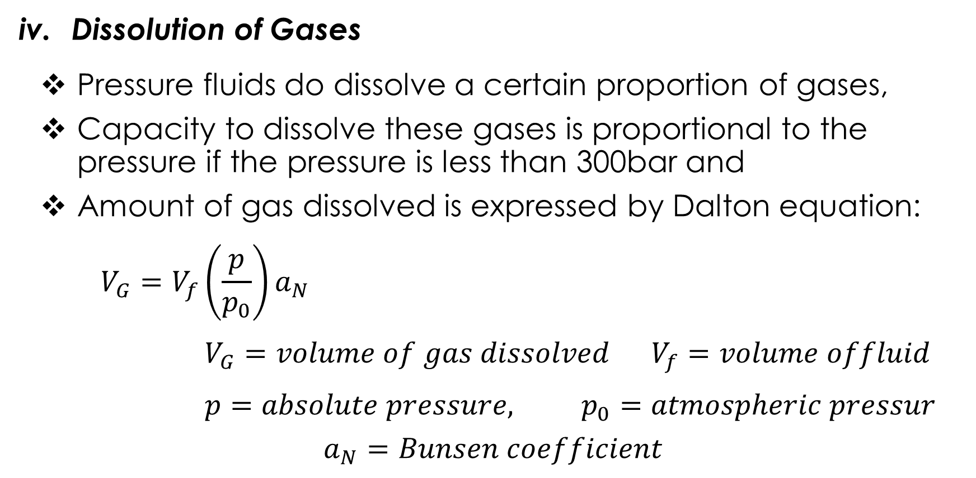
UNIT 4 : Selection Criteria of Hydraulic Fluids
Dissolution of Gases
Pressure fluids do dissolve a certain proportion of gases,
Capacity to dissolve these gases is proportional to the pressure if the pressure is less than 300bar and
Amount of gas dissolved is expressed by Dalton equation:
$$V_{G}=V_{f}\left(\frac{p}{p_{0}}\right)a_{N}$$
$$V_{G}=volume of gas dissolved V_{f}=volume offluid$$
$$p=absolute pressure, p_{0}=atmospheric pressur$$
$$a_{N}=Bunsen coefficient$$

Slide 51
UNIT 4 : Selection Criteria of Hydraulic Fluids
Cavitation
Due to dissolved gases or air coming out of a fluid forming bubbles,
Even if dissolved gases are not present, the fluid may ''boil'' when its pressure becomes too low, or its temperature too high.
Evaporation or boiling occurs at atmospheric temperature when the pressure is reduced to the saturation vapour pressure,
This can result out of a higher fluid velocity,
Actual problem is the high explosive nature of these gases near surfaces when the fluid re-enters a high pressure zones.

Slide 52
UNIT 4 : Selection Criteria of Hydraulic Fluids
Cavitation can take place in:
a. suction pipe lines and canals of pumps,
Causes: Lower absolute pressure due to:
  losses in fittings, curves, reduced cross-sectional areas,
  long suction heights,
  higher velocities.
Effects: erosion of parts, power losses, high noise, pressure shocks etc.
b. Throttles, orifices, etc.
Causes: Lower pressures due to high velocities
Effects: high noise, erosion, instability of their controls, change in the flow characteristics

Slide 53
UNIT 4 : Selection Criteria of Hydraulic Fluids
Cavitation Protective Measures:
Choice of material with resistance to erosion on surface,
Reducing the pressure differences on a single pressure reducing element (serial connection of such elements),
Deviating the cavitation’s jet away from critical areas

Slide 54

UNIT 4 : Selection Criteria of Hydraulic Fluids
Material compatibility
Hydraulic fluid must not negatively affect the materials of components such as coatings, seals, hoses, metals and plastics

Slide 55
UNIT 4 : Selection Criteria of Hydraulic Fluids
Aging (oxidation and Polymerisation)
Oxidation is a reaction with oxygen to form acidic bases.
Polymerisation is the increase in the length of the C-H chain, and it leads to the formation of sludge,
Acceleration of aging can be due to:
High operating temperatures.
Presence of foreign air,
Presence of water and other impurities,
Presence of metallic catalyst (mostly Cu and Cu-alloys)

Slide 56
UNIT 4 : Selection Criteria of Hydraulic Fluids
Aging (oxidation and Polymerisation) Neutralisation Number:
It is a scale for determining the aging state of fluids,
it specifies the amount of⁻KOH necessary to neutralise 1g of the fluid.

Slide 57
UNIT 4 : Selection Criteria of Hydraulic Fluids
Air separation ability (ASA)
Property of a hydraulic fluid to separate undissolved air
Hydraulic fluids always contain dissolved air,
During operation, dissolved air may be transformed into undissolved air, leading to cavitation,
air separation capacity depends on the viscosity, temperature, basic fluid and aging,
It cannot be improved by additives.

Slide 58
UNIT 4 : Selection Criteria of Hydraulic Fluids
Demulsifying ability and water solubility
The capacity of a hydraulic fluid to separate water at a defined temperature is known as demulsifying ability,
For larger systems with permanent monitoring, a demulsifying fluid with good water separation capability (WSC) is recommended

Slide 59
UNIT 4 : Selection Criteria of Hydraulic Fluids
Filterability
Filterability describes the ability of a hydraulic fluid to pass through a filter, removing solid contaminants,
Filterability is a basic prerequisite for cleanliness, servicing and filtration of hydraulic fluids

Slide 60
UNIT 4 : Selection Criteria of Hydraulic Fluids
Additivation
Properties of fluids can be modified with suitable additives,
Distinction is made for fluids between heavy metal-free and heavy metal-containing (generally zinc) additives systems,
Both additive systems are most often incompatible with each other,
Increasing additivation generally leads to deteriorated air separation ability (ASA) and water separation capability (WSC) of the hydraulic fluid

Slide 61
UNIT 4 : Selection Criteria of Hydraulic Fluids
Measures taken when changing type of fluid:
thoroughly cleaning of the plant,
Replacing the seals,
Inspect / test the suction behaviour, filter and container construction,
Inspect the paintings of the container

Slide 62

Thank You
For any concerns, please contact
elearning@knust.edu.gh
elearningknust@gmail.com
0322 191132

